Slide 1


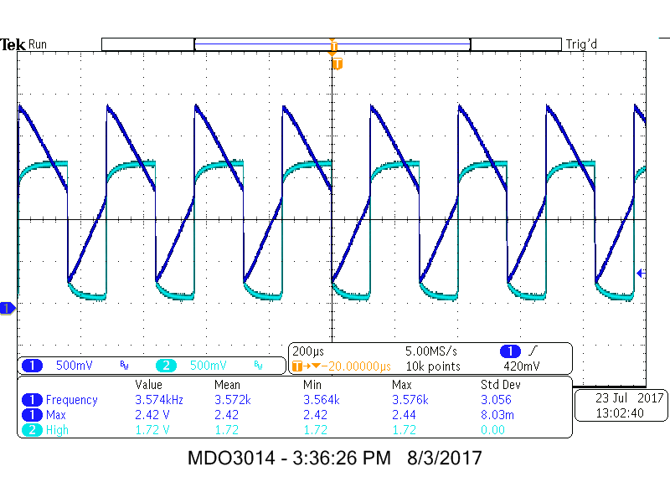
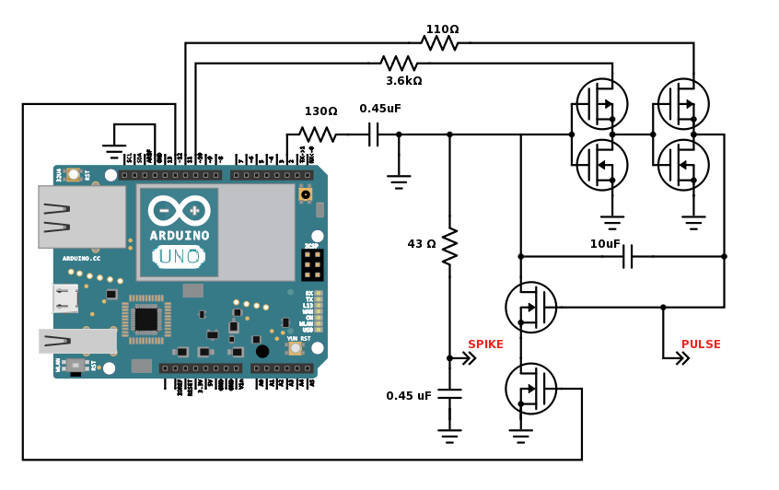
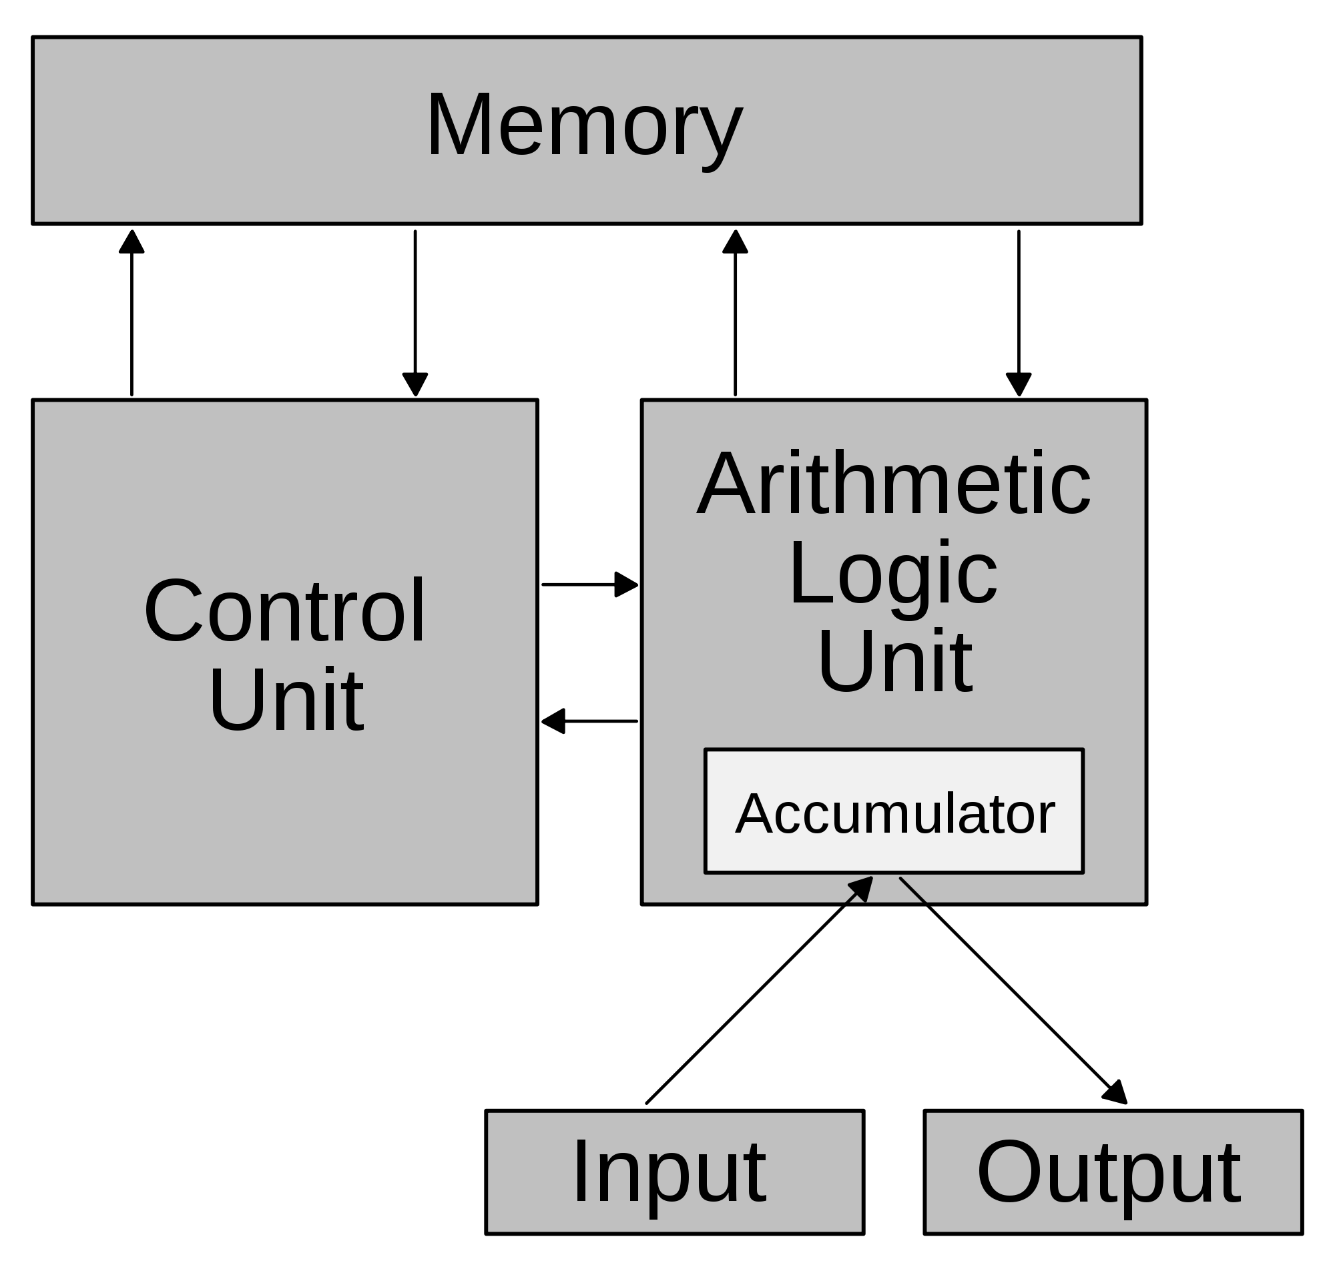
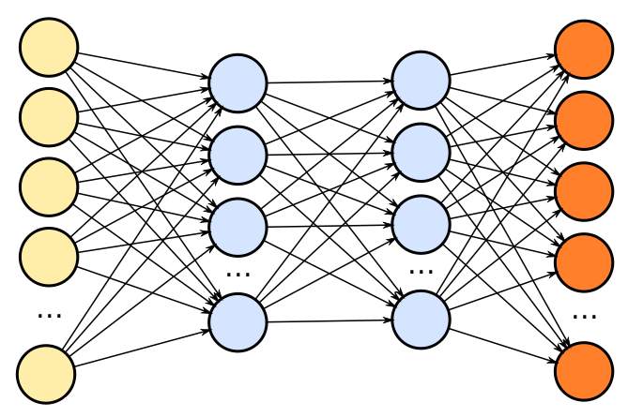
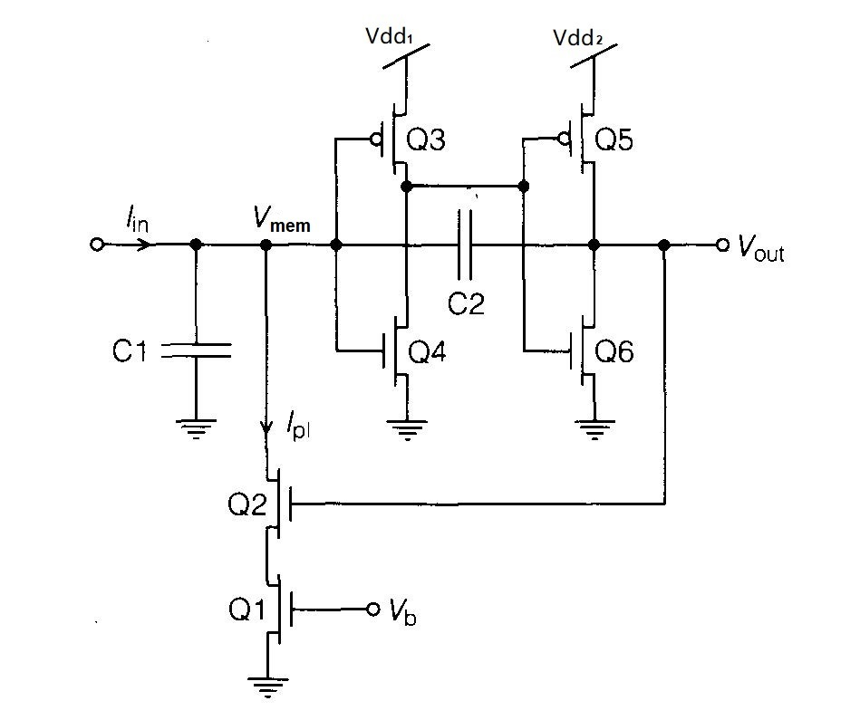
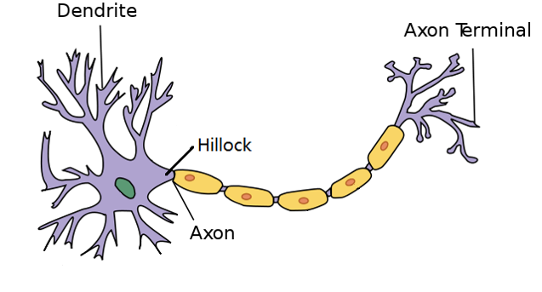
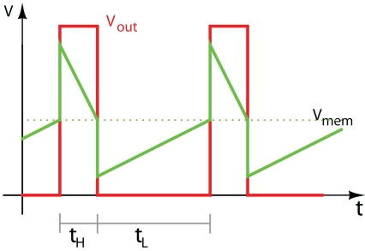
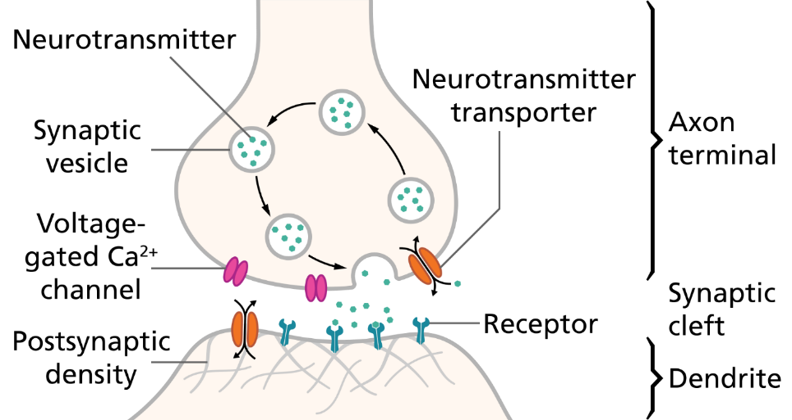
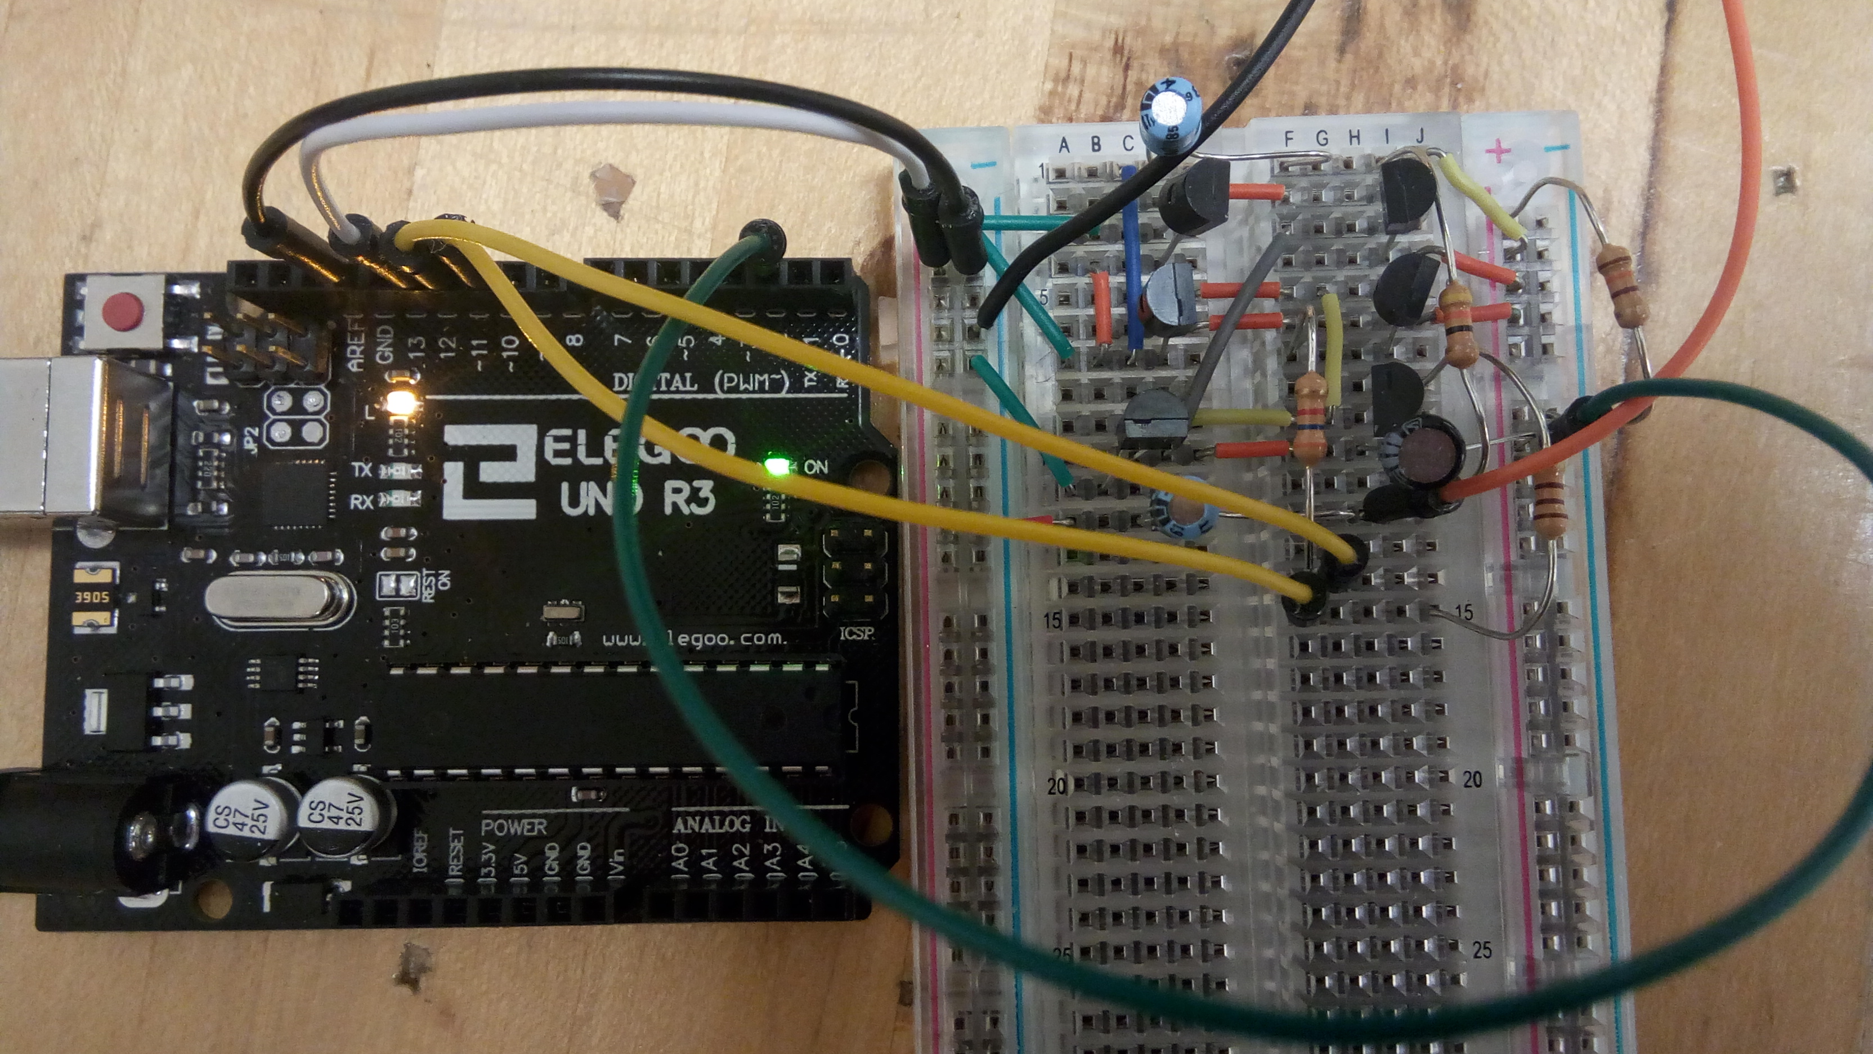
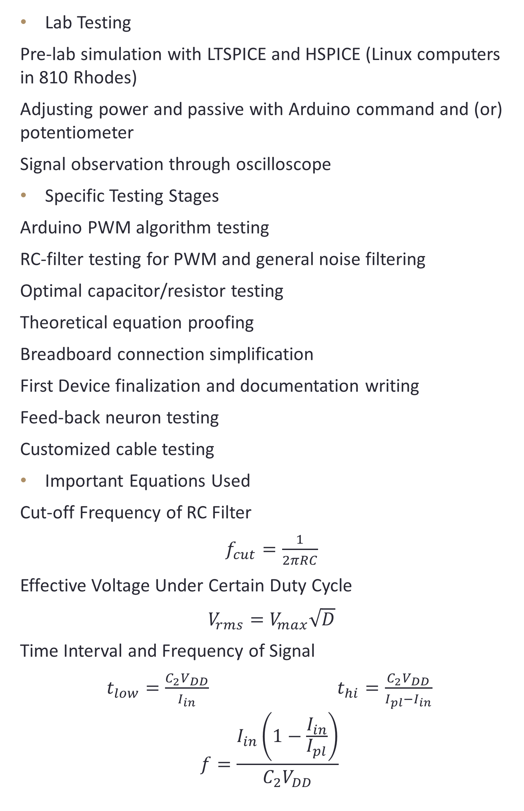
Electrical Simulation of Neural Signal
Zuguang Liu
Protégé Undergraduate Research Program 2017
abstract
Objective
Methods(continued)
Results (continued)
In Dr. Jha’s MIND (Microelectronics and Integrated-Systems with Neuro-centric Devices) Lab, the main topic of the team is to build a connection between electrical/computer systems and neural systems. Around this theme there are several subjects that the team are currently working on, and I am in the group focus on Neuron Simulations.
With the end goal to create neuromorphic computer from scratch, different members in the MIND lab are assigned to research on different parts. Although the majority of the group is focusing on a device called memristor, which simulates the behavior of synapses, my task is to simulate the neural signals.
Build a device that outputs neural signals
Research and optimize the performance of the device
Used to test memristor devices (single or crossbars)
Create actual signals for a neuromorphic-computing-based navigation model car
Lab Testing
Pre-lab simulation with LTSPICE and HSPICE (Linux computers in 810 Rhodes)
Adjusting power and passive with Arduino command and (or) potentiometer
Signal observation through oscilloscope
Specific Testing Stages
Arduino PWM algorithm testing
RC-filter testing for PWM and general noise filtering
Optimal capacitor/resistor testing
Theoretical equation proofing
Breadboard connection simplification
First Device finalization and documentation writing
Feed-back neuron testing
Customized cable testing
Important Equations Used
Cut-off Frequency of RC Filter
$f_{cut}=\frac{1}{2πRC}$
Effective Voltage Under Certain Duty Cycle
$V_{rms}=V_{max}\sqrt{D}$
Time Interval and Frequency of Signal
$t_{low}=\frac{C_{2}V_{DD}}{I_{in}}$ $t_{hi}=\frac{C_{2}V_{DD}}{I_{pl}−I_{in}}$
$$f=\frac{I_{in}\left(1−\frac{I_{in}}{I_{pl}}\right)}{C_{2}V_{DD}}$$
Specs on Signals
Turn on
Discharge
Turn off
Charge
Background
Figure 5 - Sample Signals Captured by Oscilloscope
Neuromorphic Computing
Neurons from Biology to Electrical Engineering
Von-Neumann Architecture | Neuromorphic Computing
Jumping between processor and memory | Memory-controlled processing network
methods
Processor
Memory
Spikes – changes of input current due to the cycle
Pulses – digital signal output from the cycle
Axon-Hillock Device
Based on Mead’s (1989) Axon Hillock Circuit
Powered by Arduino Microprocessor
Built with MOSFETs and passives on breadboard
Customized cable to pass signal through tri-axial cable
Literature Readings
Analog VLSI and Neural Systems (Mead, 1989) and other relevant papers
Basic electronic tutorial and Arduino documentation
Figure 6 - Schematic of Single AHC Device
Factors of Charging/Discharging Time?
Charging | Charging capacitor (+) | Input current (-)
Discharging | Discharging capacitor (+) | Amplifier power (+)
Feed-back Neurons
Feed-back neurons are set of two or more neurons with one’s output directly connect to another one input.
Generate signals with the same frequency but progressively smaller voltage
By adjusting the power sources, signal frequency can be boosted linearly.
results
Recommendations
Single Axon-Hillock Device
One stream of signal (spikes or pulse-train)
Adjustable frequency at run-time
23 available frequency values ranging 112 Hz to 1163 Hz
Parallel Axon-Hillock Device (not finished yet)
Custom cable connecting copper wire and tri-ax connector
Device is vulnerable to break and large for practical use (navigation car or integrated to wafer)
Arduino internal structure unknown
Feed-back neurons need further research
Theoretical equations partially not proved due to limited knowledge
Figure 1 - Neuron Structure, Isa (2014)
Acknowledgement
Figure 3 - Original Schematic and Signal Waveform of Axon-Hillock Circuit (Mead, 1989)
Research Advisor: Dr. Rashmi Jha
Mentor: Alexander Jones, Andrew Rush
Lab collages: Joshua Mayersky, Thinh Nguyen, Thomas Schultz, Caleb Smiley, Sam Wenke, Tony Bailey, Abhijeet Barua, Vishal Jain
Head of the Program: Dr. James Boerio
Administrator: Miss Magnolia Modaress
Figure 4 - Picture of Single AHC Device
Figure 2 - Chemical Transmission Through Synapse, Splettstoesser (2015)

